Slide 1


CROP YIELD PREDICTION USING KNN ALGORITHM
A Minor Project Report
in partial fulfillment of the degree
Bachelor of Technology
in
Computer Science & Artificial Intelligence
By
18K41A05B2 S.Prashanth
18K41A05B7 V.Shriya
18K41A05B9 A.Nayan Tej
18K41A05C0 A.Manasa
Under the Guidance of
Dr. P Praveen Assoc. Prof, CS&AI Department
Submitted to
SCHOOL OF COMPUTER SCIENCE & ARTIFICIAL INTELLIGENCE
SR UNIVERSITY, ANANTHASAGAR, WARANGAL
April, 2023.

Slide 2
ABSTRACT
In Indian history, agribusiness has been the foundation of the economy. This agrarian action stay lacking because of different components. The vast majority of the exercises territory unit through with a shortfall of late innovation. As of now, seed characterization is finished upheld data of individual. the point of this investigation is to take a gander at the forecast of harvests which will offer high return inside the given area considering the environment and soil boundaries

Slide 3
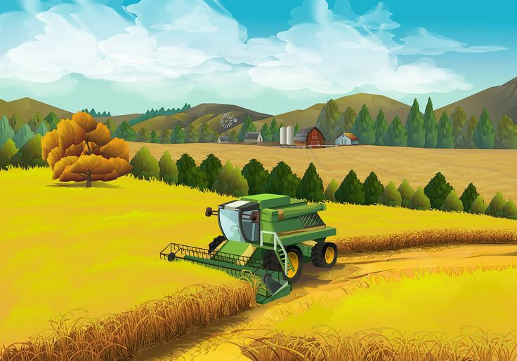
PROBLEM STATEMENT
In our country large amount of population are depending on agriculture though government is taking financial steps to help farmers still they are facing problems due to lack of data analysis and prediction on crops.

Slide 4

OBJECTIVEs
Our objective is to develop an application using machine learning for predicting which crop to be used based on soil condition using k nearest neighbor classification.

Slide 5
Literature Review
For motivation and Background work we refered to some of the following Reserch Papers from online. They are
Agricultural Crop Yield Prediction Using Artificial
Neural Network Approach.
Crop Prediction Based on Geographical and Climatic
Machine Learning and Deep Learning.
A Survey on Crop Recommendation Using
Machine Learning.
Analysis and prediction of crop yields for
agricultural policy purposes

Slide 6
Proposed Methodology
Accuracy depends on the quality of the data. With large data, the prediction stage might be slow. Sensitive to the scale of the data and irrelevant features. Require high memory – need to store all of the training data.
Given that it stores all of the training, it can be computationally expensive.

Slide 7
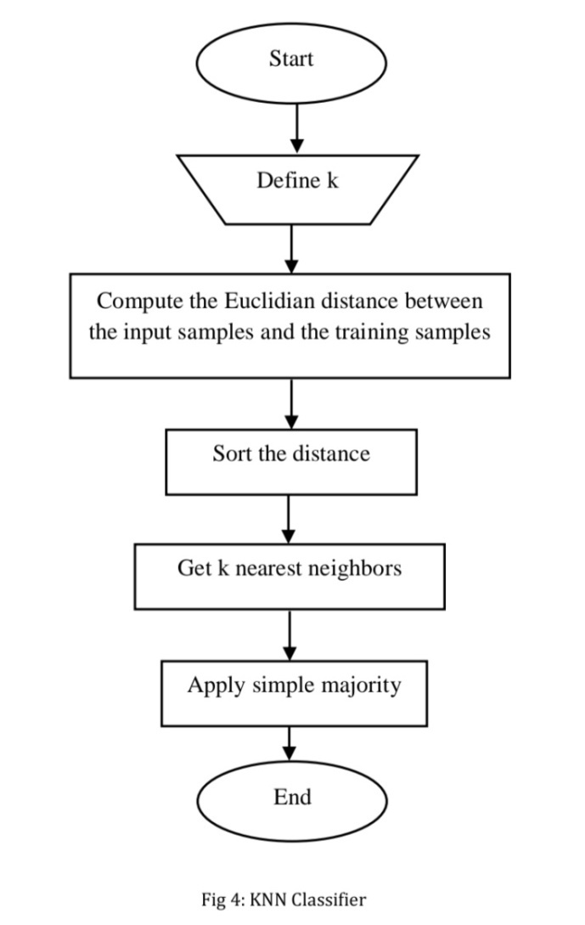
Proposed ALGORITHM
KNN is a supervised machine learning algorithm.
The formula used is d(x,y)**2 = (x1-x2)**2+(y1-y2)**2

Slide 8
DATA SET
Data about Rainfall, temperature, humidity and various other factors are collected and analyzed. This analysis will be fed to the prediction model. The prediction for the manufacturing of the crop relying on past records is made to assist farmers and industries by means of imparting them records about crop manufacturing.

Slide 9
KNN Algorithm
The k-nearest neighbor (k-NN) method is a data mining technique.
In this, we consider each of the characteristics in our training set as a different dimension in some space, and take the value an observation has for this characteristic to be its coordinate in that dimension, so getting a set of points in space.
The implementation of algorithm can be noted as below:
Load the data
Initialize K to your chosen number of neighbors

Slide 10
Prediction of Crop Yield through K-NN
This work represents a evaluation of K-NN method for the early prediction of crop yield. K-NN analysis is used for predicting the unknown parameter from the recognized parameters.
In this work we’re thinking about season, location, humidity and area as enter parameters that are the main parameters to be considered for an excellent crop yield.
The unknown cost of crop yield may be predicted from the closest known values are calculated from Euclidean distance between them.
To calculate The distance among p and q ,the Euclidean metric is Commonly used by if a=(a1, a2) and b=(b1,b2) then the Distance is given by
D(a, b) = √(b1 – a1)2 + (b2 – a2)2.

Slide 11
Result:
The system is build to help the farmers to increase their production and predict the crop suitable for their requirements. We used KNN algorithm in this system to predict the crop based on the previous data reports. Here we considered parameters like state , district , area to cultivate , season , previous year data as inputs. The prediction of the past records is to help farmers so that they can have a accurate production. Data can be collected from the user and result is given as suitable crop. After the collection of data from the previous year prepare a csv file. Import all the required libraries like pandas , numpy , sklearn. There are 5 variables to enter as input . The variable are district name, crop year, season, crop, area. And the attributes should be converted into values from string based on their efficiency. The result will be accuracy rate of the algorithm and the suitable crop. Here we got the result like accuracy in 57% for k=5 and the predicted crop according to the input for the customer.

Slide 12
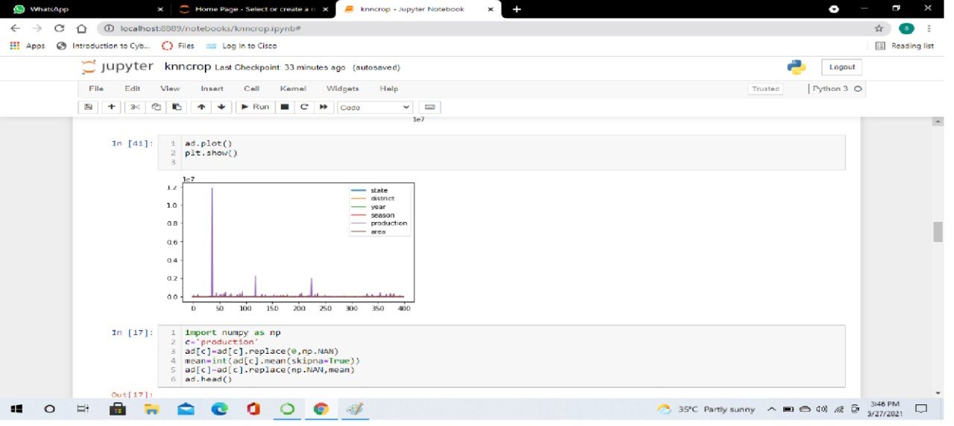
Results

Slide 13
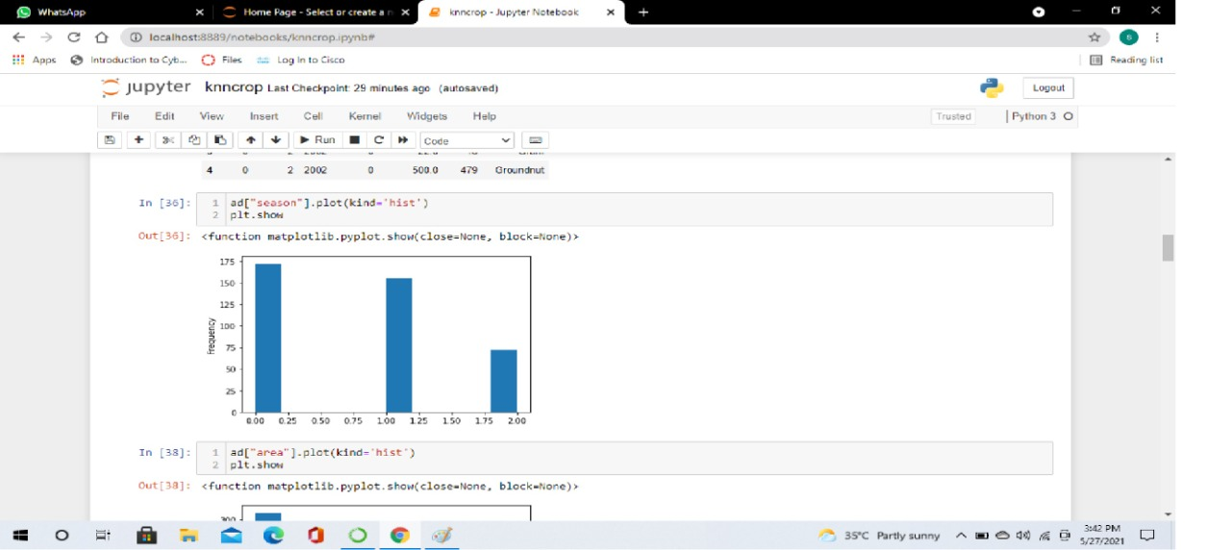
Results

Slide 14
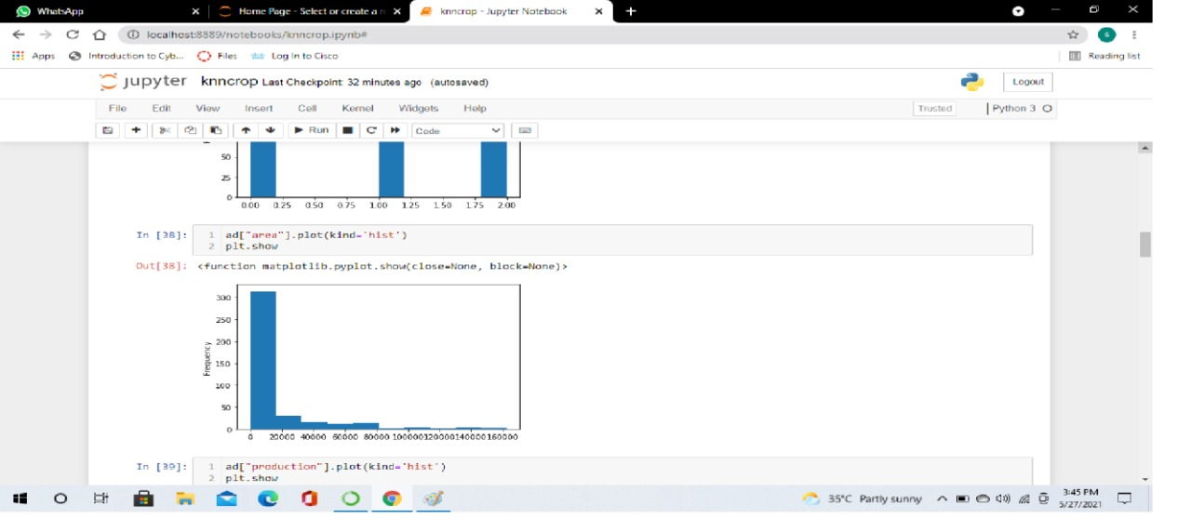
Results

Slide 15
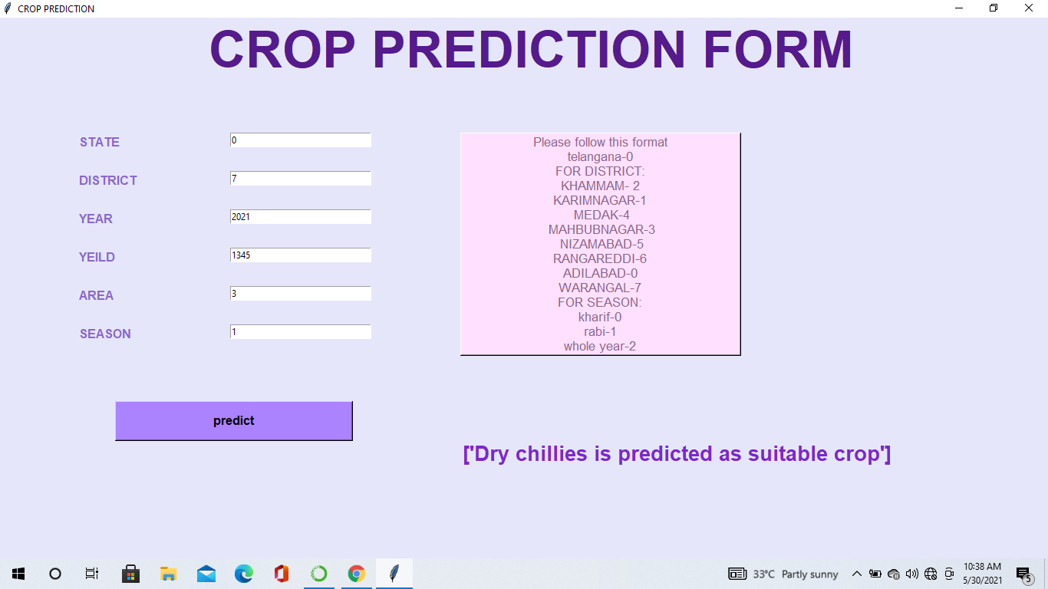
Web Page Format

Slide 16
Conclusion
Here we conclude that the prediction of crop is depended on the agricultural parameters of the customer. The dataset of the customer requirements is available . so the prediction of suitable crop becomes easy using KNN algorithm. Here we considered parameters like state , district , area to cultivate , season , previous year data as inputs. The prediction of the past records is to help farmers so that they can have a accurate production. Data can be collected from the user and result is given as suitable crop. There are 5 variables to enter as input . The variable are district name, crop year, season, crop, area. And the attributes should be converted into values from string based on their efficiency. The result will be accuracy rate of the algorithm and the suitable crop. Here the crop prediction system is implemented in efficient way only using a single algorithm KNN with high accuracy rate and suitable crop as prediction.

Slide 17
References
Add maximum 10 references
Which includes papers
Books
Websites, etc.

Slide 18
THANK YOU

